Slide 1


Kate Gilmartin
CEO British Hydropower Association
REMA: Second round consultation

Slide 2


BHA is the leading trade membership association solely representing the interests of the UK hydropower industry
Our Mission is to drive growth in the sector by engaging, influencing and promoting Hydropower, Tidal Range and Pumped Storage Hydro, making these technologies relevant within the Government’s ambition to enable a decarbonised, secure grid by 2035.

Slide 3
Review of the Electricity Market Arrangements Consultation
  Consultation doc found here
  Introduction
  4 Challenges
  28 Questions
  Corresponding documents
    Options Assessment found here
    9 technical research supporting documents found here
  Closes 7th May
Notes:
Fossil fuels have done 3 things, kWs, flexibility and storage - renewables powered grid is very different. We’ve done a great job of bringing forward the Renewables kWs, but the flexibility requirements and storage have massively lagged

Slide 4
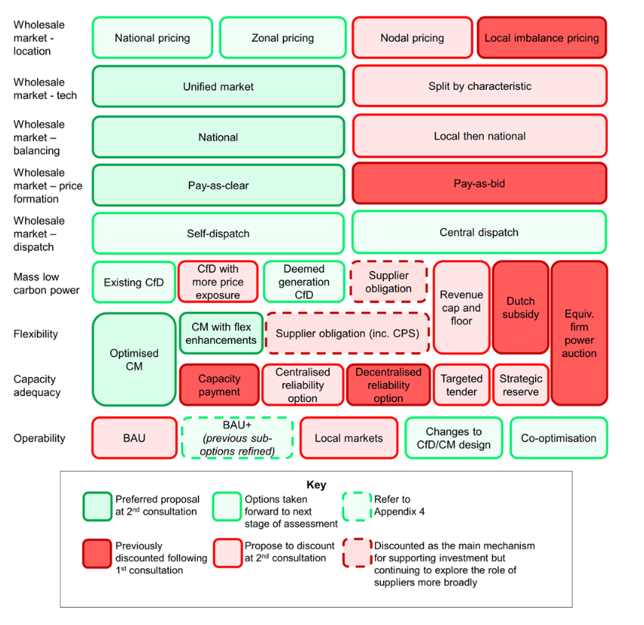
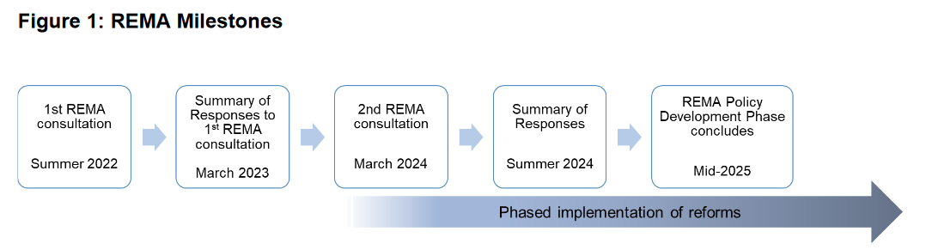
Summary to date

Slide 5
Points to note
REMA programme focuses on core electricity markets:
The wholesale market, Balancing Mechanism, ancillary services,
Policies that impact these – including the evolution of and alternatives to the CfD scheme and the CM.
It needs to consider:
  Value for money (previously ‘least cost’).
  Deliverability
  Investor Confidence
  Whole system flexibility
  Adaptability
Creation of NESO: National Energy System Operator
Objectives:
Drive progress towards net zero while maintaining energy security and minimising costs for consumers.
Responsibilities across electricity, gas and hydrogen, including all the existing functions of the Electricity System Operator (ESO),
Enhanced whole system approach to planning and operating the energy sector.
Undertaking whole system strategic planning, with the first Centralised Strategic Network Plan due in 2026, and providing advice to government and Ofgem to inform key policy decisions.

Slide 6
Challenge 1:
Passing through the value of a renewables-based system to Consumers
(Wholesale market features)
Retain marginal pricing across the wholesale market and future-proof the CfD scheme;
Monitor the evolution of the Corporate Power Purchase Agreement (CPPA) market, where we believe there could be significant room for growth;
Pursue a cross-cutting approach to incentivising electricity demand reduction.
Passing through the value of a renewables-based system to consumers:
How best to decouple electricity prices to pass through the benefits of renewables to consumers and what is the role of marginal pricing within the electricity markets?
How can CPPAs benefit different consumers and developers of low carbon capacity, and how might this role evolve?
How best we best incentivise electricity demand reduction from consumers and what is the role of markets in doing this?
Notes:
Fossil fuels have done 3 things, kWs, flexibility and storage - renewables powered grid is very different. We’ve done a great job of bringing forward the Renewables kWs, but the flexibility requirements and storage have massively lagged

Slide 7
Challenge 2:
Investing to create a renewables-based system at pace
(Mass Low Carbon generation & CfD mechanism)
Commit to retain a CfD-type scheme as the primary and most effective mechanism for driving investment in renewable generation to deliver net zero.
Consult on further range of reform options for CfD:
  Deeming CfD payments or
  Moving to a capacity-based CfD,
  Reference price reform/ Partial CfD, and
  Restricting the percentage of capacity in the CfD
Investing to create a renewables-based system at pace:
How to de-risk investment in renewables while increasing operational exposure to deliver lowest overall system cost?
Notes:
Fossil fuels have done 3 things, kWs, flexibility and storage - renewables powered grid is very different. We’ve done a great job of bringing forward the Renewables kWs, but the flexibility requirements and storage have massively lagged

Slide 8
Challenge 3:
Transitioning away from an unabated gas-based system to a flexible, resilient, decarbonised electricity system
Capacity Adequacy & Flexibility
Retain the Capacity Market (CM) implement shorter-term reforms to the CM
Development of bespoke policy to support technologies such as Power CCUS, Hydrogen to Power (H2P) and Long Duration Electricity Storage (LDES)
Optimised CM: introducing a minimum procurement target to better support investment in low carbon flexible technologies.
GB electricity system could require up to 55GW of short-duration flexibility and between 30 and 50GW of long-duration flexibility
Set out updated expectations of the amount of flexibility we will need on the electricity system in 2035
Accelerate progress and reforms within the current market framework to support distributed flexibility, and review whether additional steps are needed.
Transitioning away from an unabated gas –based system to a flexible resilient decarbonised electricity system:
How do we maintain security of supply in the future electricity system dominated by intermittent renewable generation?
How do we manage a smooth transition away from unabated gas to low carbon flexible technologies?
Notes:
Fossil fuels have done 3 things, kWs, flexibility and storage - renewables powered grid is very different. We’ve done a great job of bringing forward the Renewables kWs, but the flexibility requirements and storage have massively lagged

Slide 9
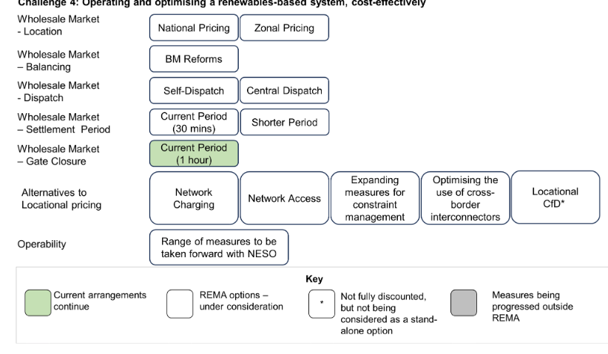
Challenge 4:
Operating and optimising a renewables-based system, cost-effectively
Wholesale Market: Location, Balancing, Dispatch, Settlement, Gate closure, operability
Consider strengthening locational signals in the market by assessing two options: zonal & locational investment signals;
working with Ofgem on reforms to network charging and transmission access
Consider centralised dispatch, alongside the option of a reformed BM.
Discount nodal pricing
Discount the ‘local markets’ model
Develop proposals for an electricity system operability strategy for 2035.
Operating and optimising a renewables-based system, cost effectively
How do we ensure that efficient price signals are sent in the wholesale market so that whole systems costs are minimised?
How do we improve mechanisms and markets for balancing the system?
How do we ensure sufficient liquidity is maintained under future market arrangements?
Notes:
Fossil fuels have done 3 things, kWs, flexibility and storage - renewables powered grid is very different. We’ve done a great job of bringing forward the Renewables kWs, but the flexibility requirements and storage have massively lagged

Slide 10
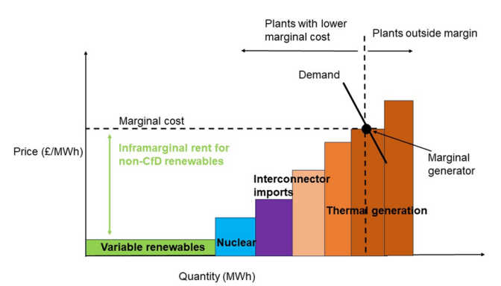
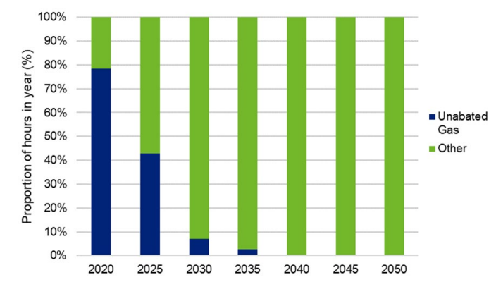
Challenge 1:
The role of marginal pricing in sending market signals: How to squeeze out gas..
Wholesale markets operate on short-run marginal cost (SRMC) – the cost of producing the next additional unit of electricity. For gas-fired = fuel costs; for renewables such as wind and solar = low as costs are mostly long-run marginal cost (LRMC) – the total cost of producing a unit of electricity, including capital costs associated with construction.
The difference is called Inframarginal rent
Proportion of hours in the year where unabated gas is the marginal plant.
The low SRMC of renewables = periods of low wholesale market when renewables are setting the marginal price.
CfD can protect consumers during periods of high wholesale prices, as they provide a limitation on inframarginal rent.
Notes:
Fossil fuels have done 3 things, kWs, flexibility and storage - renewables powered grid is very different. We’ve done a great job of bringing forward the Renewables kWs, but the flexibility requirements and storage have massively lagged

Slide 11
Challenge 1:
Corporate PPAs: long-term agreements for the purchase of electricity at an agreed price between a developer and corporate counterparty, including businesses and public sector organisations. Currently only 3.5GW subscribed to CPPA
  High counterparty risk: the risk of the organisation buying or selling the electricity defaulting on its payments.
  High transaction costs: CPPA deals are often complex and require a high level of commercial and legal expertise,
  Contract length Developers may require long contract lengths to secure investment whereas organisations may not be able to commit to buying power far in advance
  Demand mismatches: supply exceeds the corporate’s needs, leaving the generator with a potentially significant time period without a guaranteed buyer.
Renewable Energy Guarantees of Origin (REGOs): government is currently undertaking a review of the REGO scheme, how it can further benefit the production of renewable electricity? eg ‘bundled’ as part of a CPPA so that organisations can evidence their low carbon power supply.
Demand Reduction: Market-based models for demand reduction
Conclusions and next steps Challenge 1
  Proceeding with the rapid rollout of renewable generation via a CfD-type scheme (see Challenge 2), alongside maintaining a wholesale market based on short-run marginal pricing.
  Not continuing to consider transformational Split Market and GPP options.
  Considering the potential role of CPPAs and how they might grow and evolve in future to support further renewable and low carbon deployment.
  Strengthening our cross-cutting approach to ensuring cost-effective levels of electricity demand reduction are delivered.

Slide 12
Challenge 2: Investing to create a renewables-based system at pace
(Mass Low Carbon generation & CfD mechanism)
How do we significantly scale up renewables investment?
How do we maximise CfD assets’ responsiveness to system needs?
What is the best way for the CfD to distribute risk across electricity market participants
Ensuring the CfD is fit for the future (Q 4&5)
  How the CfD will need to adapt to meet the changing needs of our decarbonising system
  Scale up
  Maximise responsiveness to system needs
  Operational signals: the current CfD design incentivises maximum generation output
  Investment signals: the CfD auction awards contracts based on a ‘strike price’ which impacts project characteristic signals, ie, maximise output, rather than maximise overall system benefit, eg no investment in enabling ancillary services.
  Volume risk: This risk for generators is the uncertainty around how much electricity their asset will be able to sell. future electricity supply may exceed demand more often, leading to more frequent zero or negative pricing periods. The CfD exaggerates this issue by incentivising renewables to generate even when they are not required to meet demand
Scope of CfD reform (Q6-13)
Conclusions and next steps
Notes:
Fossil fuels have done 3 things, kWs, flexibility and storage - renewables powered grid is very different. We’ve done a great job of bringing forward the Renewables kWs, but the flexibility requirements and storage have massively lagged

Slide 13
Challenge 2:
Type of signal | Signal | Description | How current CfD design impacts signal
Operational | Dispatch | Should a generator produce or curtail a marginal unit of power at a given point in time? | Distortive: Generators have an incentive to produce as much power as possible, regardless of system requirements or intra-day prices, during all periods of non-negative day-ahead IMRP.
 |  |  | Distortive: During network constraints CfD generators will require turn down payments in the BM equal to the foregone difference payment
 |  |  | Distortive: Generators are incentivised to bid in the wholesale market in the same way (‘herding’), leading to potentially expensive cliff edges when price becomes negative due to the negative pricing rule, making it difficult for the system operators to manage the system.
 | Storage and flexibility | If co-located with flexibility, when should a generator charge and discharge the asset? | No significant impact: Metering arrangements confirmed by the LCCC mean a generator should be fully incentivised to charge and discharge co-located storage in accordance with market prices.
 | Alternative use | What else could / should a generator do with the asset? For example, should they provide an ancillary service? | Distortive: During non-negative day-ahead price periods, generators will only provide ‘turn down’ ancillary services where the revenue available from doing so exceeds their foregone difference payments, regardless of the true real time value of power versus the system value of the service.
 | Trading | How should a generator trade their power? | Distortive: Intermittent renewable generators have a strong incentive to trade exclusively in the day-ahead market to avoid basis risk. This may negatively impact the ability of suppliers to hedge, which in turn could lead to higher consumer costs. In addition, once the day ahead price clears positive, generators may face a distortive incentive to trade at negative intraday prices.
Investment | Location | Where should a new project be located within GB? | Potentially distortive: The fixed strike price in all periods leads to minimal revenue incentive to locate in areas that have less renewable deployment, despite being beneficial for the overall system and assets potentially benefiting from higher prices in good local weather conditions. However, this distortive impact is weak relative to the locational investment signals and distortions present in wider market arrangements (discussed in Challenge 4).
 | Project characteristic | Which technology, what size? Should a project co-locate with storage? Should you invest in equipment to provide ancillary services? | Potentially distortive: The CfD system incentivises developers to maximise their potential to generate at all times, regardless of wider market opportunities. Specifically, having payment linked to output with a fixed strike price in all periods may reduce incentives to invest in equipment to provide ancillary services.
Notes:
Fossil fuels have done 3 things, kWs, flexibility and storage - renewables powered grid is very different. We’ve done a great job of bringing forward the Renewables kWs, but the flexibility requirements and storage have massively lagged

Slide 14
Challenge 2: Investing to create a renewables-based system at pace
(Mass Low Carbon generation & CfD mechanism)
Scope of CfD reform (Q6-13)
Small-scale renewables
Small-scale renewable projects could play a key role in the UK meeting its carbon budgets and net zero targets. They also offer societal benefits such as engaging local communities in renewable energy projects, tackling fuel poverty by reducing energy bills and creating new jobs.
One suggestion was to open the CfD to more small-scale deployment, with many projects currently locked out by minimum capacity requirements. Following stakeholder engagement, we decided that small-scale generators would struggle to compete with larger projects for support through the CfD. Opening the CfD to more sub-5MW generators might also complicate budget setting.
Small-scale generators we spoke to said that the administrative burden would also put off many from entering.
Some respondents also pointed to the potential of local markets (e.g. reorient the wholesale market around local, distribution-level markets to more effectively utilise the distribution network) in driving small-scale renewables. This is not an option we believe has sufficient merit to be progressed.
We say more on this in Challenge 4.
Notes:
Fossil fuels have done 3 things, kWs, flexibility and storage - renewables powered grid is very different. We’ve done a great job of bringing forward the Renewables kWs, but the flexibility requirements and storage have massively lagged

Slide 15
Challenge 2: Investing to create a renewables-based system at pace
(Mass Low Carbon generation & CfD mechanism)
Scope of CfD reform (Q6-13)
Continued…
Similarly, some commented on the need to reform the Smart Export Guarantee (SEG). Ofgem reports annually on the range, nature and uptake of tariffs offered by suppliers in response to their SEG obligations. To date, the market has responded positively, with a range of SEG tariffs, demonstrating the fact that market-led approaches to delivering small-scale renewables can be successful.
Where we do see some potential for existing markets to increase small-scale deployment is through PPAs, as set out in Challenge 1. According to BNEF, most corporate PPAs in the UK are for projects above 5MW. We would welcome views on whether and how the PPA market could evolve alongside existing mechanisms, such as the SEG, and other REMA reforms, in growing small-scale renewables
Conclusions and next steps
  They will consider AR7 consultation response at the same time as this..
  deeper assessment of the remaining CfD reform options, aiming to complete this ‘policy’ stage of the programme by mid-2025.
  We recognise that implementation of wholesale market reforms, in particular locational pricing, could have significant implications for existing CfD assets and those looking to participate in upcoming Allocation Rounds. Challenge 4 considers this in more detail.
Notes:
Fossil fuels have done 3 things, kWs, flexibility and storage - renewables powered grid is very different. We’ve done a great job of bringing forward the Renewables kWs, but the flexibility requirements and storage have massively lagged

Slide 16
Challenge 3:
Transitioning away from an unabated gas-based system to a flexible, resilient, decarbonised electricity system
Capacity Adequacy & Flexibility
Expect to need 55GW of short-duration flexibility and between 30 to 50GW of long-duration flexibility (as much of this long-duration capacity as possible to be low carbon).
Retain the CM as our capacity adequacy.
Government proposes to introduce a minimum procurement target (‘minima’), into the CM (which we are calling an ‘Optimised CM’)
to better reflect the role and value of low carbon flexible technologies in the CM
Whilst bespoke mechanisms may be needed to initiate deployment of these projects, in the long-term, the Optimised CM should be the primary scheme for supporting the deployment of a competitive mix of low carbon flexibility.
Delivering Flexibility and security of supply
Low carbon flexibility faces a range of challenges:
A lack of sufficiently granular time and location-based operational signals to incentivise the flexible and efficient operation of assets in response to system needs e.g. during sustained periods of system stress.
Higher investment costs from technologies being First of a Kind and with uncertain future operating profiles, and low carbon flexibility not being sufficiently valued in current market arrangement.
To address these challenges, we need to ensure that the electricity market is designed in a way that sends:
  Sharper operational signals demonstrating when and where valuable flexibility is needed, and to which these technologies can respond; and
  sufficient investment signals to bring forward technologies and services of all sizes and types.

Slide 17
Challenge 3:
Transitioning away from an unabated gas-based system to a flexible, resilient, decarbonised electricity system
Capacity Adequacy & Flexibility
Ensuring a secure and reliable low carbon system
  Reforming the Capacity Market (Optimised CM):
    current technology-neutral CM to date has brought forward mostly fossil fuel-based generation.
    Valuing characteristics such as low carbon capacity and/or the flexibility capabilities needed to meet key system requirements, such as:
      ‘response time’ - the speed at which assets can respond to signals; and
      ‘sustained response’ - the ability to sustain capacity over a prolonged period of time.
    taking forward the single auction with multiple clearing prices auction design, with a minimum procurement target
    Further work is underway to develop how minima should be defined and set
    CM also needs to reflect the changing nature of security of supply through:
      Auction targets: for years beyond the four-year ahead (T-4) Delivery Years,
      Considering further changes: to mitigate risks to security of supply. consult on further CM changes in due course.
      Ensuring the reliability standard is fit for purpose: exploring changing nature of future stress events
      The GB Reliability Standard metric – 3 hours Loss of Load Expectation (LOLE), we expect the nature of future stress events to change.
        more correlated weather-driven reductions in supply, with increased risk of extended periods of system stress and larger reductions in output;
        plant outages no longer being a defining factor in system stress; and
        increased instances where system stress likely occurs outside of peak demand periods
Notes:
Fossil fuels have done 3 things, kWs, flexibility and storage - renewables powered grid is very different. We’ve done a great job of bringing forward the Renewables kWs, but the flexibility requirements and storage have massively lagged

Slide 18
Challenge 3:
Transitioning away from an unabated gas-based system to a flexible, resilient, decarbonised electricity system
Capacity Adequacy & Flexibility
Delivering the flexibility needed for a secure and decarbonised power system
“Based on our internal analysis we expect that a limited amount of new build gas capacity will be required in the immediate term to ensure a secure and reliable system, to replace existing generation capacity as it expires. It is the only mature technology capable of providing sustained flexible capacity whilst low carbon long-duration alternatives, such as Power CCUS, H2P, and LDES scale up as we move into the 2030s.”
sharper operational signals are required to strengthen the investment case for distributed flexibility.
The key barriers to sharper operational signals are:
inefficient market operations;
barriers to market access;
temporal signals that do not fully reflect system needs; and
locational signals that do not fully reflect system needs.
Transitioning away from bespoke support
Bespoke support mechanisms may be essential for developing and building confidence in novel low carbon flexible technologies. But as technology specific barriers are overcome and enabling infrastructure is rolled out, there are strong arguments for transitioning back to technology neutral, price-competitive allocations at the earliest opportunity. The Optimised CM should be the primary scheme for supporting the deployment of a competitive mix of low carbon flexibility.
Notes:
Fossil fuels have done 3 things, kWs, flexibility and storage - renewables powered grid is very different. We’ve done a great job of bringing forward the Renewables kWs, but the flexibility requirements and storage have massively lagged

Slide 19
Challenge 3:
Transitioning away from an unabated gas-based system to a flexible, resilient, decarbonised electricity system
Capacity Adequacy & Flexibility
Discounted options
The following options will not be taken forward for further consideration: cross-technology revenue cap and floor, Centralised Reliability Options, Strategic Reserve, and a Targeted Tender
Conclusions and next steps
We will progress the development of bespoke policy to support deployment of low carbon long-duration flexibility in the short term, including through the consultations on H2P and LDES published in December 2023 and January 2024 respectively.
We will retain the CM as our capacity adequacy mechanism but optimise the auction to further support low carbon flexibility by introducing minima.
We will continue to assess how minima interacts with the broader CM set up, prospective bespoke support mechanisms and REMA package to ensure optimal use.
We will identify where additional optimisation may be required to ensure the CM effectively delivers REMA’s objectives.
We will review the GB Reliability Standard to ensure the metric effectively addresses future risks to security of supply.
Notes:
Fossil fuels have done 3 things, kWs, flexibility and storage - renewables powered grid is very different. We’ve done a great job of bringing forward the Renewables kWs, but the flexibility requirements and storage have massively lagged

Slide 20
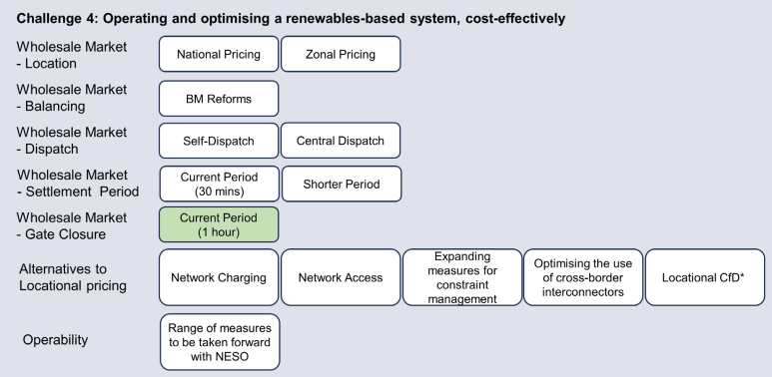
Challenge 4:
Operating and optimising a renewables-based system, cost-effectively
Wholesale Market: Location, Balancing, Dispatch, Settlement, Gate closure, operability
In the next stage of REMA, we will seek to develop both national and zonal models of wholesale market reform to enable a comparison between the two with the aims of designing models which can most appropriately allocate risk to market participants while delivering savings for consumers
We will also continue to consider where reforms to status quo elements such as settlement periods, the Balancing Mechanism, and operability services can deliver benefits for the system and consumers. We will no longer consider the ‘local markets’ model; instead, we will continue to consider what further actions are needed in order to deliver open, dynamic and coordinated markets for distributed low carbon flexibility.
1)How do we ensure that efficient price signals are sent in the wholesale market so that whole-system costs are minimised?
2) How do we improve mechanisms and markets for balancing the system?
3) How do we ensure sufficient liquidity is maintained under future market arrangements?
Notes:
Fossil fuels have done 3 things, kWs, flexibility and storage - renewables powered grid is very different. We’ve done a great job of bringing forward the Renewables kWs, but the flexibility requirements and storage have massively lagged

Slide 21
Challenge 4:
Operating and optimising a renewables-based system, cost-effectively
Wholesale Market: Location, Balancing, Dispatch, Settlement, Gate closure, operability
New challenges for keeping the system operating dependably and cost effective:
Generation output is becoming harder to predict, as it is more dependent on the weather
Electricity demand will also become harder to predict as in future it will depend on demand for heating which will be weather dependent, and electric vehicle charging patterns.
Generation is located further from demand, putting additional strain on networks, and creating challenges for system operation.
Generation is no longer providing the same suite of operability services needed to run the electricity system securely e.g. inertia.
New sources of flexibility are coming into the system and are increasingly located at distribution level where they are less visible to the System Operator, making it harder to co-ordinate and use them efficiently.
Transitioning to a net zero wholesale market
Summary of REMA options
Improving locational signals
Improving temporal signals
Improving balancing and ancillary services
Improving local and national market co-ordination
Improving market liquidity
Notes:
Fossil fuels have done 3 things, kWs, flexibility and storage - renewables powered grid is very different. We’ve done a great job of bringing forward the Renewables kWs, but the flexibility requirements and storage have massively lagged

Slide 22
Challenge 4:
Operating and optimising a renewables-based system, cost-effectively
Wholesale Market: Location, Balancing, Dispatch, Settlement, Gate closure, operability
Options for sending more efficient locational signals
  Locational investment signals - incentivising where new assets should be built; and
  Locational operational signals - incentivising assets to produce or consume energy in a way that is beneficial for the system
We have considered two sets of market-based options for sending more efficient locational signals:
  • Locational pricing options: Nodal and zonal pricing. These options send both locational investment and locational operational signals through the wholesale market.
  • Alternatives to locational pricing options: transmission network charging reform, transmission network access reform, measures for constraint management, optimising the use of cross-border interconnectors, locational CfD and locational CM.
  These options primarily send a locational investment signal, outside of the wholesale market.
Notes:
Fossil fuels have done 3 things, kWs, flexibility and storage - renewables powered grid is very different. We’ve done a great job of bringing forward the Renewables kWs, but the flexibility requirements and storage have massively lagged

Slide 23
Challenge 4:
Operating and optimising a renewables-based system, cost-effectively
Wholesale Market: Location, Balancing, Dispatch, Settlement, Gate closure, operability
Options set 1 – Locational pricing options – assessment of options and rationale for decisions
The aim of locational pricing is to incentivise generation and demand; (i) locate in parts of the network where they would offer most value to the system and (ii) operate more efficiently to lower system costs.
Locational pricing would embed the locational value of energy into the wholesale price of electricity so it reflects the balance of supply and demand, as well as available network capacity, in each location.
This would mean different geographic locations would have different wholesale prices
Under locational pricing, one would expect areas with significant generation output relative to demand to have lower wholesale prices and vice versa
In the first consultation, we presented two options for introducing locational pricing: zonal pricing and nodal pricing.
The difference between the two is price granularity and dispatch. Nodal pricing sends a more granular locational signal, delivering different prices at hundreds of transmission nodes, but would require centralised dispatch
Zonal pricing, in contrast, would split GB’s wholesale market into a far smaller number of regional zones, for example up to maximum of a dozen.
DESNZ have now discounted Nodal but will continue to explore Zonal.
Locational pricing would increase the following risks for investors (which will likely affect the cost of capital):
  • Price risk – the risk that generators make less revenue under locational pricing than they would do under national pricing (e.g. if their zone has consistently lower wholesale revenues), or that revenues are less predictable (due to changes on local supply and demand).
  • Volume risk – the risk that generators are not dispatched as often (due to changes to their firm access rights) and therefore make lower and less predictable revenues.
Implementation challenges: Introducing any form of locational pricing would be complex and take significant time. The level of difficulty would increase if central dispatch were also implemented in parallel
Notes:
Fossil fuels have done 3 things, kWs, flexibility and storage - renewables powered grid is very different. We’ve done a great job of bringing forward the Renewables kWs, but the flexibility requirements and storage have massively lagged

Slide 24
Challenge 4:
Operating and optimising a renewables-based system, cost-effectively
Wholesale Market: Location, Balancing, Dispatch, Settlement, Gate closure, operability
Options set 2 – Alternatives to locational pricing – assessment of options and rationale for decisions
Currently, the alternative options we are considering within REMA are:
Using Ofgem's pre-existing network charging reform programme (option A).
Reviewing Ofgem’s transmission network access arrangements (option B).
Expanding measures for constraint management (option C).
Optimising the use of cross-border interconnectors (option D).
Introducing a locational element to the CM (option E).
Introducing a locational element to the CfD (option F).
Option A: Using Ofgem's pre-existing network charging reform programme (TNUoS and DUoS)
TNUoS charges are the annual charges used to recover the costs of the transmission network from both demand and generation, set two months prior to taking effect.
TNUoS already sends a locational investment signal, as one component of the charge is broken down into 14 zones for demand and 27 zones for generation. Effectiveness of the investment signals sent by TNUoS is unclear at present.
There are significant differences in the generation charge between locations, and this is expected to increase further in the coming years.
The generation charges are also perceived to be volatile and hard to predict, making it challenging for market participants to respond to them in a considered manner.
Ofgem and DESNZ have agreed to work on the programme of longterm TNUoS reform to the same timeframes as the REMA process, to ensure that decisions on the two can be taken together, given the interlinkages
Notes:
Fossil fuels have done 3 things, kWs, flexibility and storage - renewables powered grid is very different. We’ve done a great job of bringing forward the Renewables kWs, but the flexibility requirements and storage have massively lagged

Slide 25
Challenge 4:
Operating and optimising a renewables-based system, cost-effectively
Wholesale Market: Location, Balancing, Dispatch, Settlement, Gate closure, operability
Option B: Reviewing Ofgem’s transmission network access arrangements
Ofgem is therefore considering how access reform within a national wholesale market could be used to improve locational investment and operational signals to bring down the costs of building and operating a high-renewables system. Access rights reform of this nature has been considered several times by Ofgem previously.
Changes to firm access rights have the potential to improve investment signals, e.g. by better incentivising new generation assets not to locate behind network constraints as they would face increased volume risk (i.e., the risk that the network cannot physically accommodate their traded position due to network constraints and they are not compensated for being asked to reduce their output).
Changing access rights for new assets: This includes limiting firm access rights for new assets and then either auctioning or centrally allocating firm access rights for new assets. Under these options, existing users would retain their current firm access arrangements.
Changing access rights for existing and new assets: This includes all transmission access rights becoming non-firm, with all assets only having firm access rights to their local area.
Option C: Expanding measures for constraint management
The options being considering include:
Expanded local constraints markets – build on the constraints market in Scotland (CMZ)
Improved forecasting of congestion. Better forecasting of future constraints would enable market participants to respond more effectively in advance of periods of network congestion.
Storage-based solutions. These could include, but may not be limited to, storage being deployed to free up more transmission capacity in congested points in the transmission network by reducing the need to set aside unutilised spare capacity for pre and post fault events, due to the ability of modern storage technology to absorb or release electricity rapidly.
Before day-ahead constraint price signal designed to discourage generation in areas behind constraints at times of congestion. We will continue to explore options for signals that could mimic the effect of locational pricing to incentivise self-curtailment
Notes:
Fossil fuels have done 3 things, kWs, flexibility and storage - renewables powered grid is very different. We’ve done a great job of bringing forward the Renewables kWs, but the flexibility requirements and storage have massively lagged

Slide 26
Challenge 4:
Operating and optimising a renewables-based system, cost-effectively
Wholesale Market: Location, Balancing, Dispatch, Settlement, Gate closure, operability
Option D: Optimising the use of cross-border interconnectors
Option E: Introduce a locational element to the Capacity Market decided to discount introducing a locational element to the CM as a standalone option.
Option F: Introduce a locational element to the CfD not continuing to develop this option
Improving temporal signals
Option 1: Shorter settlement periods
Option 2: Tighter Gate Closure
Improving balancing and ancillary services
Centralised dispatch
dispatch refers to two activities:
Determining and refining the operational schedule.
Issuing real-time dispatch instructions to generators
By contrast, centralised markets try to coordinate assets and System Operator requirements prior to Gate Closure via a centralised auction, for example at the day-ahead stage. Only contracted positions arrived at via the centralised auction feed directly into the dispatch process.
Centralised dispatch could be implemented either alongside zonal pricing, or as a standalone option.
Any transition to centralised dispatch would likely entail significant implementation costs, challenges, and risks for market participants
The ESO will be publishing results in spring 2024
Notes:
Fossil fuels have done 3 things, kWs, flexibility and storage - renewables powered grid is very different. We’ve done a great job of bringing forward the Renewables kWs, but the flexibility requirements and storage have massively lagged

Slide 27
Challenge 4:
Operating and optimising a renewables-based system, cost-effectively
Wholesale Market: Location, Balancing, Dispatch, Settlement, Gate closure, operability
Conclusions and next step
Continue to consider strengthening locational signals
Discount nodal pricing
Continue to consider centralised dispatch and reformed BM
develop proposals for operability strategy for 2035,
Discount the ‘local markets’ mode
Notes:
Fossil fuels have done 3 things, kWs, flexibility and storage - renewables powered grid is very different. We’ve done a great job of bringing forward the Renewables kWs, but the flexibility requirements and storage have massively lagged

Slide 28
Summary
Challenge 1: Passing through the value of a renewables-based system to Consumers
Proceeding with the rapid rollout of renewable generation via a CfD-type scheme (see Challenge 2), alongside maintaining a wholesale market based on short-run marginal pricing.
Not continuing to consider transformational Split Market and GPP options.
Considering the potential role of CPPAs and how they might grow and evolve in future to support further renewable and low carbon deployment.
Strengthening cross-cutting approach to ensuring cost-effective levels of electricity demand reduction are delivered.
Challenge 2: Investing to create a renewables-based system at pace
  Consider AR7 consultation response at the same time as this..
  Deeper assessment of the remaining CfD reform options, aiming to complete this ‘policy’ stage of the programme by mid-2025.
  Recognise that implementation of wholesale market reforms, in particular locational pricing, could have significant implications for existing CfD assets and those looking to participate in upcoming Allocation Rounds. Challenge 4 considers this in more detail.
Challenge 3: Transitioning away from an unabated gas-based system to a flexible, resilient, decarbonised electricity system
  We will progress the development of bespoke policy to support deployment of low carbon long-duration flexibility in the short term, including through the consultations on H2P and LDES published in December 2023 and January 2024 respectively.
  We will retain the CM as our capacity adequacy mechanism but optimise the auction to further support low carbon flexibility by introducing minima.
  We will continue to assess how minima interacts with the broader CM set up, prospective bespoke support mechanisms and REMA package to ensure optimal use.
  We will identify where additional optimisation may be required to ensure the CM effectively delivers REMA’s objectives.
  We will review the GB Reliability Standard to ensure the metric effectively addresses future risks to security of supply.
Challenge 4: Operating and optimising a renewables-based system, cost-effectively
Continue to consider strengthening locational signals
Discount nodal pricing
Continue to consider centralised dispatch and reformed BM
develop proposals for operability strategy for 2035,
Discount the ‘local markets’ mode

Slide 29
Take aways for Hydropower
Although distribution network and embedded generation / flexibility are mentioned as something that needs to be address, other than CPPAs, there are no suggestions on how this is being addressed.
Big blow re the <5MW CfD ask – we will be responding to this
Likewise for the discounting of Local Energy Markets
We will also be responding re the lack of attention at Distribution and the need to bring forward digital smart grid so there is T/D visibility and the need for AnM
We will lobby for a decarbonising the distribution network strategy that ties into LAEPs / D-FES
CPPAs are unlikely to be an increasing market without a ‘stick’ BHA will suggest a similar mechanism to the Supplier obligation through ROCS for large energy consumers with an increasing % of their consumption needing to come through CPPAs? If there is a generation/ demand shape/ profile match, this could be good for Hydropower and we could look to work with Solar to offer seasonal spread. REGOs could be key to this.
Significant CM changes coming as most CM is gas –
This could especially favour reservoir hydropower
Currently unable to participate if under other mechanism – there was discussion around this changing
Schemes need to be over 2MW, but portfolios can be aggregated to participate. SSE reported getting £63/kW as part of the T-4 (4 year ahead) capacity auction
It appears that LDES will be brought back within the CM after a bespoke mechanism is used to stimulate the deployment.
Locational pricing is still some time off, if it comes through at all. It would be impactful for Hydropower, but if Hydropower can access other mechanisms to make use of storage and its less intermittent nature than wind, this could compensate any revenue losses.
Hydropower will need to looking at revenue stacking as these markets crystalise.
The Creation of NESO is useful, and we will look forwards to reading their central dispatch report.
Labour are committed to 2030 decarbonisation of the grid, if they are elected they will need to put additional focus on the Distribution Network.

